Slide 1
SE-3002 Software quality engineering
Part IV-QUANTIFIABLE QUALITY IMPROVEMENT
Feedback Loop and Activities for Quantifiable Quality Improvement
Lecture # 36
Notes:
Hi Raghvendra, good to know about you. My Selenium WebDriver with Java tutorial for beginner is available at- https://youtu.be/2SzdhH8xAX4

Slide 2
Today’s Outline
Feedback Loop and Activities for Quantifiable Quality Improvement
Feedback Loop and Overall Mechanism
Monitoring and Measurement
Analysis and Feedback
Tool and Implementation Support
Notes:
Chapter 14 SQA by Jeff Tian

Slide 3
quantifiable quality improvement basic elements
Part IV is quantifiable quality improvement, which includes two basic elements:
Quantification of quality through quantitative measurements and models so that the quantified quality assessment results can be compared to the pre-set quality goals for quality and process management.
Quality improvement through analyses and follow-up activities by identifying quality improvement possibilities, providing feedback, and initiating follow-up actions.

Slide 4
quantifiable quality improvement
To support quantifiable quality improvement, various parallel and follow-up activities to the main quality assurance (QA) activities are needed, including:
Monitoring the specific QA activities and extracting relevant measurement data.
Analyzing the data collected above
Providing feedback to the QA and development/maintenance activities and carrying out follow-up actions based on the analysis results above.

Slide 5
Importance of Feedback Loop
All QA activities covered in Part II and Part III need additional support: .
Planning and goal setting
Management via feedback loop
When to stop?
Adjustment and improvement, etc.
All based on assessments/predictions

Slide 6
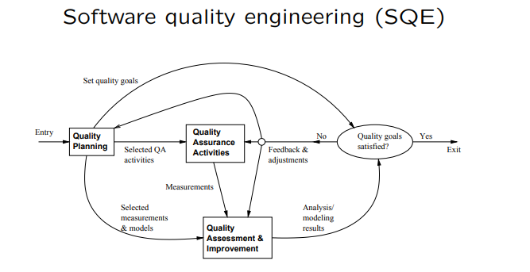
QE Activities and Process Review
Major activities:
Pre-QA planning (Part I)
QA (Part II and Part III)
Post-QA analysis & feedback – Part IV (maybe parallel instead of “post-”)

Slide 7
Feedback Loop Related Activities
Monitoring and measurement: .
defect monitoring ∈ process management
defect measurement ∈ defect handling
Analysis modeling:
Historical baselines and experience
Choosing models and analysis techniques
Goal: assessment/prediction/improvement.
Feedback and follow-up
Frequent feedback: assessment/prediction
Possible improvement areas identified

Slide 8
Quality Monitoring and Measurements
Quality monitoring needs:
Ensure proper execution of QA activities through various measurements.
Provide measurement data to analysis and modeling activities.
Direct and indirect quality measurements:
Direct quality measurement: Result and defect measurement, Such as total fault count

Slide 9
Indirect Quality Measurements
Indirect quality measurements: Why?
Other quality measurements (reliability) need additional analyses/data.

Slide 10
Indirect Measurements: Environment
Process characteristics
Entities and relationships
Specific development techniques used,
People characteristics
Skills and experience
Roles: planners/developers/testers
Product characteristics
Product/market environment

Slide 11
Indirect Measurements: Internal
Product internal measurements: most studied/understood in SE
Software artifacts being measured:
Mostly code-related
Sometimes SRS, design, docs etc.
Product attributes being measured:
Control: e.g., control flow paths
Data: e.g., operand count
Notes:
Structures:
Unstructured: e.g., LOC
Structured: examples above

Slide 12
Indirect Measurements: Activity
Execution/activity measurements:
Overall: e.g., cycle time, total effort.
Phased: profiles/histograms.
Testing activity examples:
Timing during testing/usage
Path verification (white-box)

Slide 13
Analyses, Feedback, and Follow-up
Most feedback/followup relies on analyses.
Types of analyses:
Product release decision related like quality and other goal satisfied.
Various other factors: project schedule, resource utilization, competitive pressure etc.
Types of feedback loop: (important)
Shorter (termination of sub-phases and transition to the next one) vs. longer (aimed overall organizational improvements over many projects and many years) feedback loops.
Immediate feedback: frequent feedback without analyses.
Medium-term feedback.

Slide 14
Feedback Loop Implementation
Feedback loop at different duration/scope levels.
Immediate feedback to current development activities (locally).
Short-term or sub-project-level feedback:
most of the feedback/followup
transition, schedule, resource,
destination: development activities.
Medium-term or project-level feedback:
overall project adjustment and release
destination: major blocks
Longer-term or multi-project feedback:
to external destinations

Slide 15
Implementation Support Tools
Type of tools:
Data gathering tools.
Analysis and modeling tools.
Presentation tools.
Data gathering tools:
Defects/direct quality measurements:
from defect tracking tools.
Environmental data: project db.
Activity measurements: logs.
Product internal measurements:
commercial/home-build tools.
New tools/APIs might be needed.

Slide 16
Implementation Support Tools
Analysis and modeling tools:
Dedicated modeling tools:
e.g., SMERFS and CASRE for SRE
General modeling tools/packages:
e.g., multi-purpose S-Plus, SAS.
Utility programs often needed for data screening and processing.
Presentation tools:
Aim: easy interpretation of feedback ⇒ more likely to act on.
Graphical presentation preferred.

Slide 17
Strategy for Tool Support
Using existing tools ⇒ cost↓:
Functionality and availability/cost.
Usability.
Flexibility and programmability.
Integration with other tools.
Tool integration issues:
Assumption: multiple tools used. (All-purpose tools not feasible/practical.)
External rules for inter-operability,
common data format and repository.
Multi-purpose tools.
Utilities for inter-operability.

Slide 18
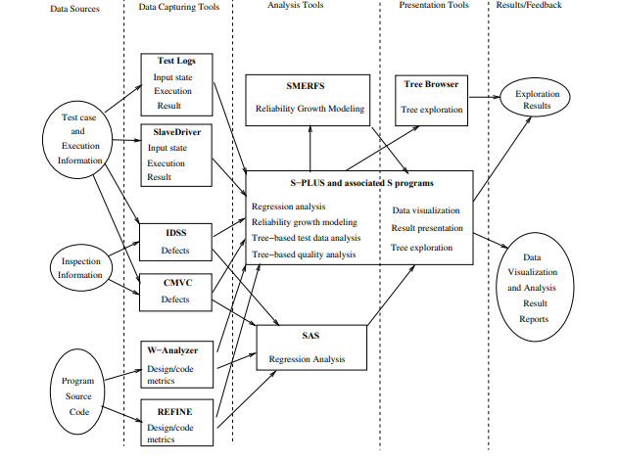
Tool Support Example
Notes:
• IBM example: Fig 18.3 (p.319).

Slide 19

That is all
Notes:
Data flow coverage link
https://www.cs.wm.edu/~kemper/cs435/slides/l15.pdf

